Slide 1
Restaurant Location Recommender – New York City
Coursera capstone project – Yizhou lu

Slide 2
Table of Contents
Introduction/Business Problem
Data Needed for Analysis
Methodology
Results
Discussion
Conclusion

Slide 3
Introduction/Business Problem
The number of restaurants in NYC was recorded at 26,697 in 2017, which is up from 25,305 in 2014 [1].
With the number of restaurants increasing, it can be anticipated that the competition in the NYC restaurant business will be even stronger in the future.
It is critical for future restaurant owners to understand where to open their restaurant based on his/her desired restaurant type.
Build a restaurant location recommender using New York City as an example.

Slide 4
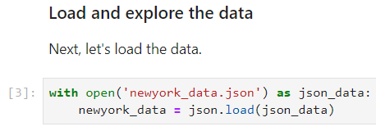
Data Needed for Analysis
JSON Data of New York City
Includes 5 boroughs and 306 neighborhoods
Essential for obtaining information of neighborhoods (borough/neighborhood name, latitude/longitude)
Basic segmentation for the location suitability score – final product

Slide 5
Data Needed for Analysis
Foursquare Location Data
Hundreds of categories of restaurants in NYC with various types of details
Can access details including ID, name, exact location (latitude, longitude), URL, contact information, ratings, tips and other statistics.
Provide insights into the competitiveness of a certain type of restaurants (cuisine, style, etc.) in each neighborhood.

Slide 6
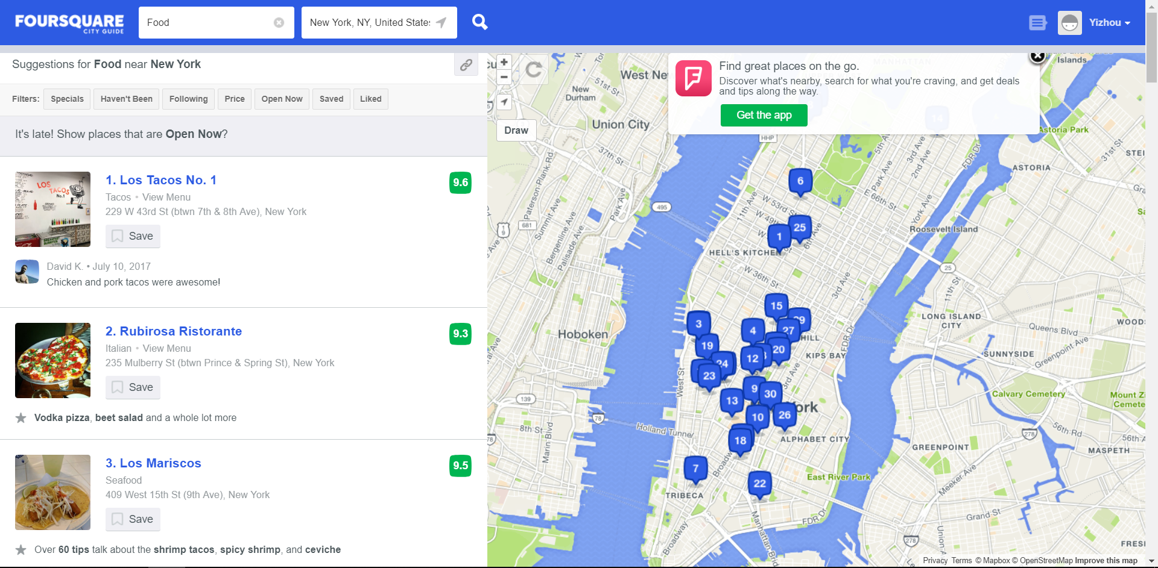
Example of Foursquare GUI Based on Location Data

Slide 7
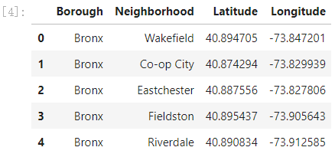
Methodology - Neighborhoods
Imported modules: numpy, pandas, json, requests, matplotlib and scipy
Create the neighborhoods data frame (borough name, neighborhood name and exact location of the neighborhoods (latitude and longitude) from the JSON file.

Slide 8
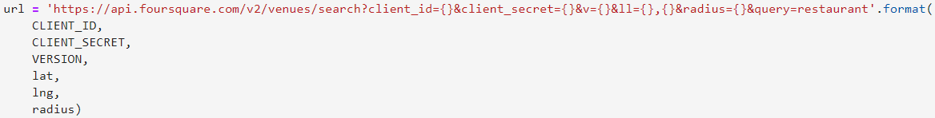
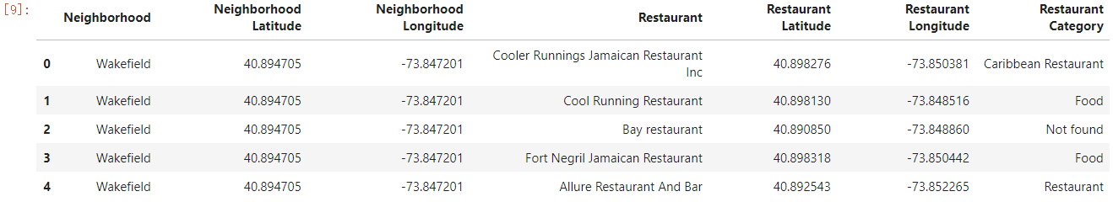
Methodology – URL Request
A search request URL with a query of ‘restaurant’ is established to request all the restaurants within a 500m radius of the default center point of each neighborhood.
Name, location and category of the restaurants was extracted, to create a new dataframe:

Slide 9
Methodology – URL Request
The function named ‘NeighborhoodRestaurants’ was created to integrate:
Create the request URL for all the restaurants in each neighborhood within a radius of 500 meters.
Make the GET request and acquire the results.
Extract relevant information for each nearby restaurant.
Create a data frame containing the relevant information for all the nearby restaurants.
Drop the duplicates, which can occur due to a restaurant being searched for more than one neighborhood.

Slide 10
Methodology – Data Cleaning
Rule out all the irrelevant venues (Automotive Shop, Design Studio, etc.) that are not restaurants.
Category names were manually examined
Venues with empty category name were categorized as ‘Not Found’ and ruled out as well
Restaurant Categories:
Some categories can be part of another category (e.g. ‘Hunan Restaurant’, ‘Shanghai Restaurant’ and ‘Szechuan Restaurant’ all belong to ‘Chinese Restaurant’): ‘Chinese Restaurant’ was renamed ‘Generic Chinese Restaurant’.
Some categories were very generic and vague, like ‘Food’ and ‘Restaurant’: combined into a single category ‘Unknown Type Restaurant’.

Slide 11
Methodology – Data Cleaning
Rule out all the irrelevant venues (Automotive Shop, Design Studio, etc.) that are not restaurants.
Category names were manually examined
Venues with empty category name were categorized as ‘Not Found’ and ruled out as well
Restaurant Categories:
Some categories can be part of another category (e.g. ‘Hunan Restaurant’, ‘Shanghai Restaurant’ and ‘Szechuan Restaurant’ all belong to ‘Chinese Restaurant’): ‘Chinese Restaurant’ was renamed ‘Generic Chinese Restaurant’.
Some categories were very generic and vague, like ‘Food’ and ‘Restaurant’: combined into a single category ‘Unknown Type Restaurant’.

Slide 12
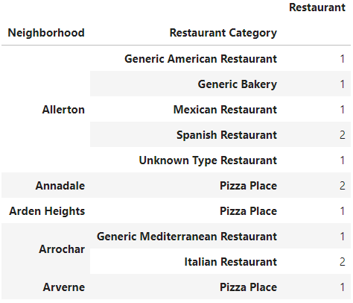
Methodology – Data Cleaning
Restaurant Categories (Continue):
Some of the categories could be combined (e.g. ‘Dim Sum Restaurant’ and ‘Cantonese Restaurant’).
Some of the categories were actually synonyms: (e.g. ‘Coffee Shop’ and ‘Cafe’, ‘Food Court’ and ‘Fast Food Restaurant’, etc.)
Through data cleaning, the total number of restaurant categories was down to 101.

Slide 13
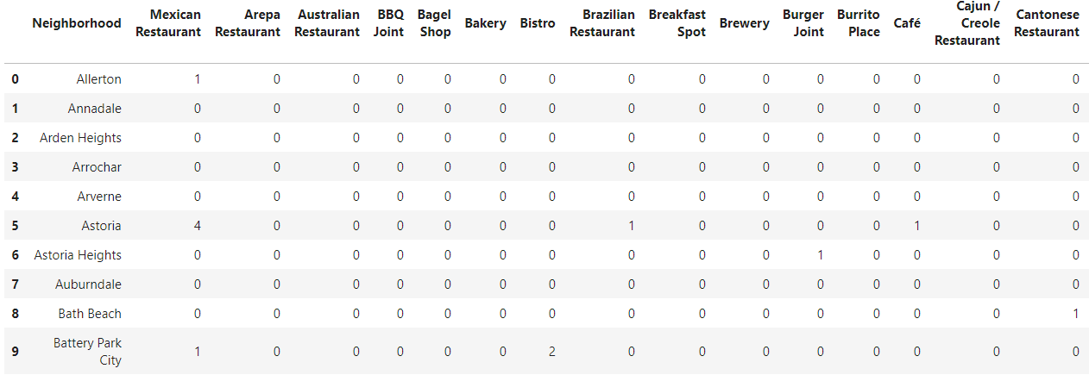
Methodology – One-hot Encoding
One-hot encoding was used to create a more orderly data frame more friendly for statistical analysis.
The encoded data frame was grouped by neighborhoods and count was applied to all 101 categories.

Slide 14
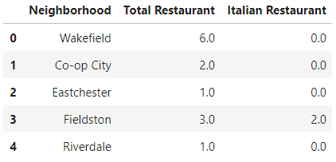
Methodology – Recommender Creation
The total number of all restaurants and the specific category of restaurants that the owner wants to open was included:
Distances between neighborhoods: distance_matrix in scipy. Compute a 306*306 square distance matrix including mutual distances of all neighborhoods.

Slide 15
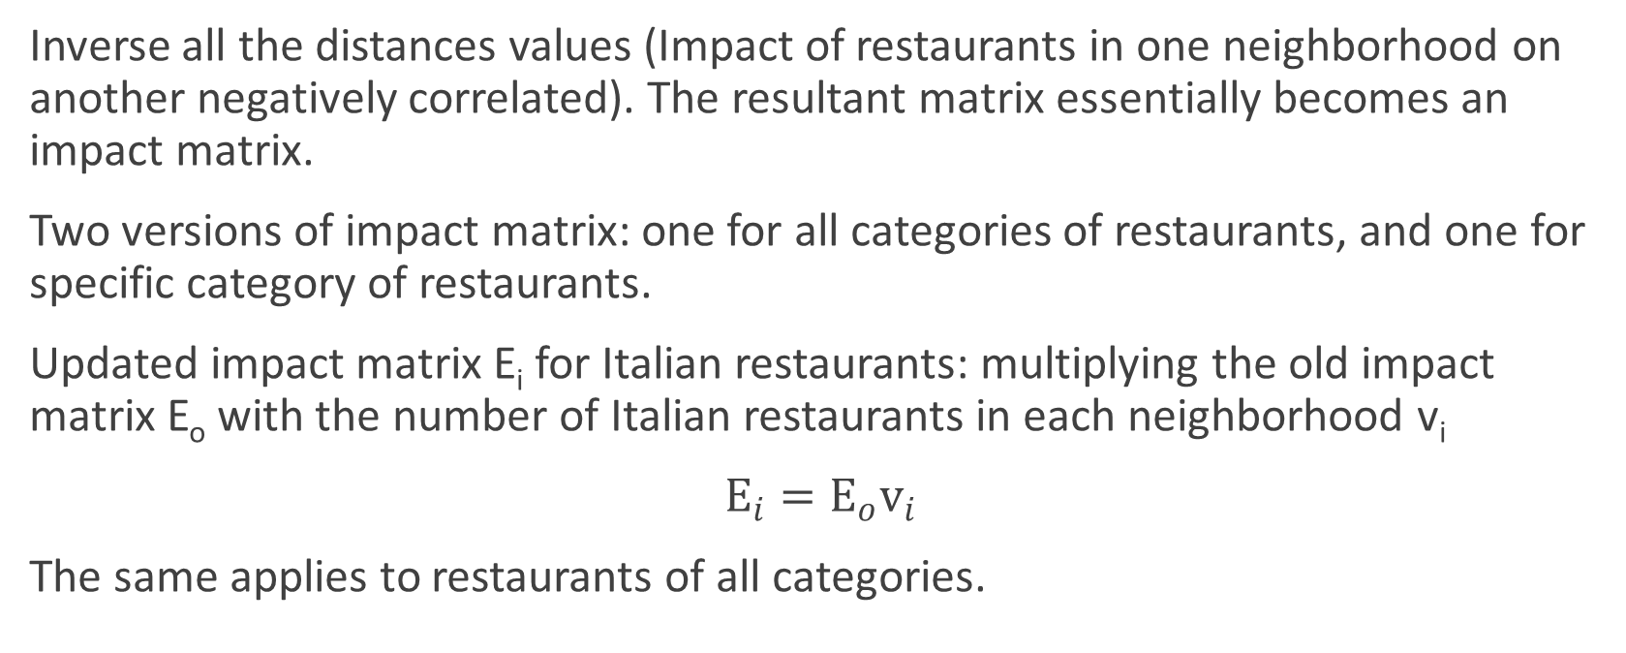
Methodology – Recommender Creation
Inverse all the distances values (Impact of restaurants in one neighborhood on another negatively correlated). The resultant matrix essentially becomes an impact matrix.
Two versions of impact matrix: one for all categories of restaurants, and one for specific category of restaurants.
Updated impact matrix E_{i} for Italian restaurants: multiplying the old impact matrix E_{o} with the number of Italian restaurants in each neighborhood v_{i}
$E_{i}=E_{o}v_{i}$
The same applies to restaurants of all categories.

Slide 16
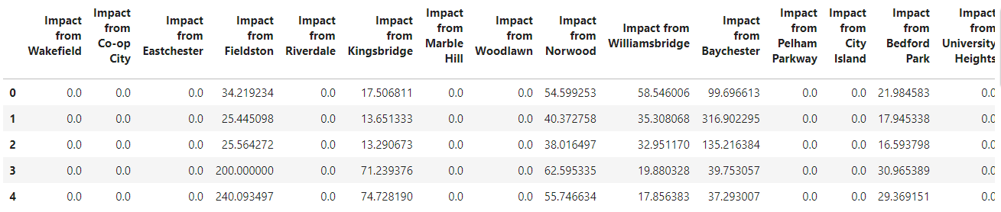
Methodology – Recommender Creation
The updated matrix E_{i} was then transformed into a data frame. Each column represents the impact from a specific neighborhood to the current neighborhood in rows.

Slide 17
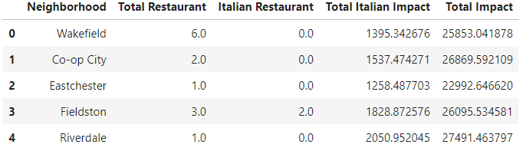
Methodology – Recommender Creation
The impact scores were summed in columns to compute the total impact score of Italian restaurants in NYC to a new Italian restaurant in each neighborhood.
The same procedure applied to the total number of restaurants of all categories as well.
Both impact scores were added to the recommender.

Slide 18
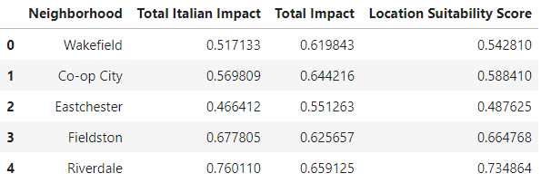
Methodology – Recommender Creation
Now that the impact scores were derived from the total number of restaurants, drop the first two columns.
Simple scaling normalization of the two series of impact scores were conducted.
For the final location suitability score, a weighted sum was adopted. By default, 0.25 and 0.75 was used for the weights of Total Impact and Total Italian Impact, respectively.

Slide 19
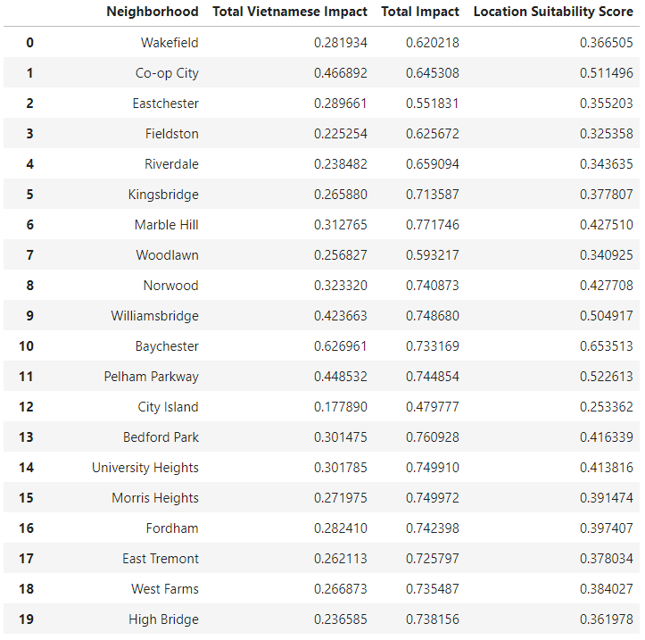
Results
Test the location suitability score of opening a new Vietnamese restaurants in all NYC neighborhoods:

Slide 20
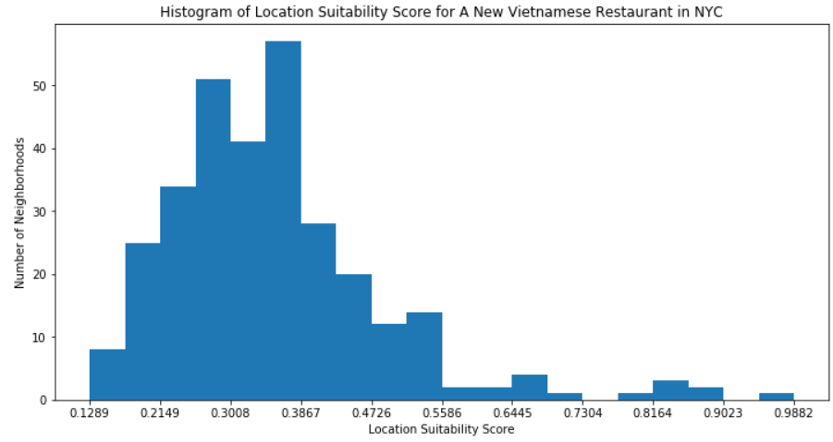
Results – Visualization
Visualize the distribution of location suitability scores of all 306 NYC neighborhoods: most of the neighborhoods earned scores around 0.2-0.4. A very small set earned scores above 0.75 or so.

Slide 21
Discussion
This restaurant location recommender is just a preliminary recommender, providing a single metric in the range of neighborhoods.
It was assumed Every neighborhood is NYC is densely populated enough and is easily accessible. i.e. Opening a new restaurant where peer competition is minimal is always more likely to be profitable.
The assumption may not be always true in reality.
If more detailed JSON data covering the available retail spaces within every neighborhood would be available, it is possible to create a more refined recommender.

Slide 22
Discussion
Had wanted to consider more factors from Foursquare location data, such as ratings of a restaurant, and the number of people that have visited a restaurant, which is a symbol of popularity of a restaurant.
Limited number of premium calls (500 every day), led to giving up on this idea.
Nevertheless, this recommender is a handy, simple yet effective tool for narrowing the choice of a new restaurant location down from the entire NYC containing 306 neighborhoods to a much smaller number of neighborhoods.
The restaurant owners only need to look at the available commercial spaces in the periphery of these neighborhoods to choose the final location.

Slide 23
Conclusion
This report addresses the development of a restaurant location recommender aiming to help future restaurant owners to open new restaurants in New York City.
NYC JSON data and Foursquare location data were used to extract information of over 100 categories of restaurants currently available in NYC.
Extensive data cleaning and distance matrix were performed.
The outcome includes a set of location suitability scores straightforward to understand.

Slide 24
Thank you for your attention!

